Slide 1

GreenBot
Greenhouse Robot : Mechatronics Prototype project
ME 102B
Team #22
Team Members:
Bader AlKhawashki, Arunima Basu, Fritz Kuermayr, Salvador Gonzalez

Slide 2
Del. 4A
Farmers work long hours, but they cannot always be inside their greenhouses to constantly check humidity and adding nutrients to soils every set number of hours.
Even small changes in these conditions can affect plant health and crop yield.
Many existing automation systems are either too expensive or too complicated for everyday use, especially for small and medium sized farms. Because of this, farmers need a simple and affordable way to monitor and control their greenhouse environment even when they are not physically present.
Our GreenBot is designed to solve this problem by helping farmers easily manage greenhouse conditions remotely and automatically, reducing stress, saving time, and improving crop growth.

Slide 3
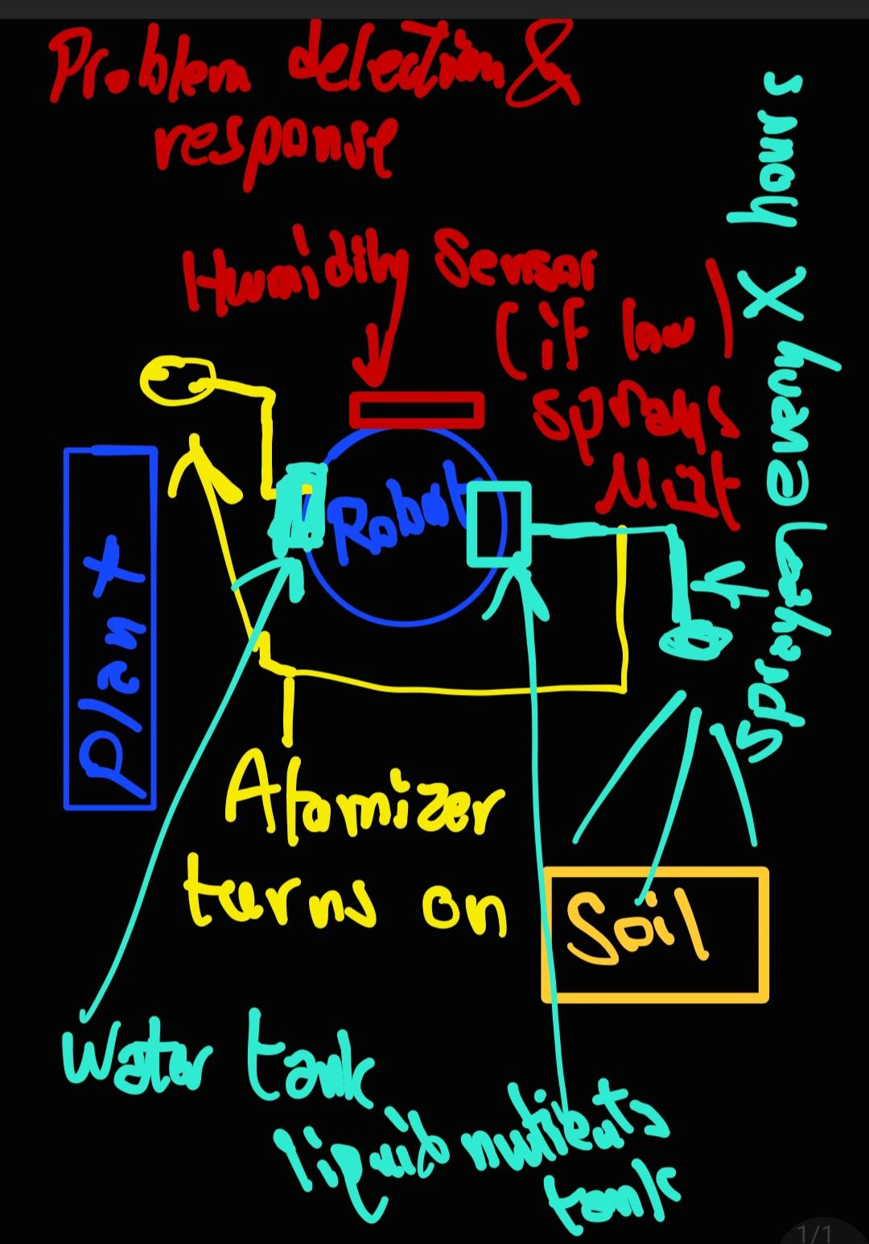
Del. 4B
Figure 1: Deliverable 4.B Cartoon
* Degrees of Freedom: robot moves in any direction on the ground using motors. Sprayer can extend and retract (could be switched to static sprayer), humidity sensor stays static
** Subject to change
GreenBot continuously monitors key greenhouse humidity conditions. When values drift outside target ranges, it automatically triggers the correct response (humidification).

Slide 4
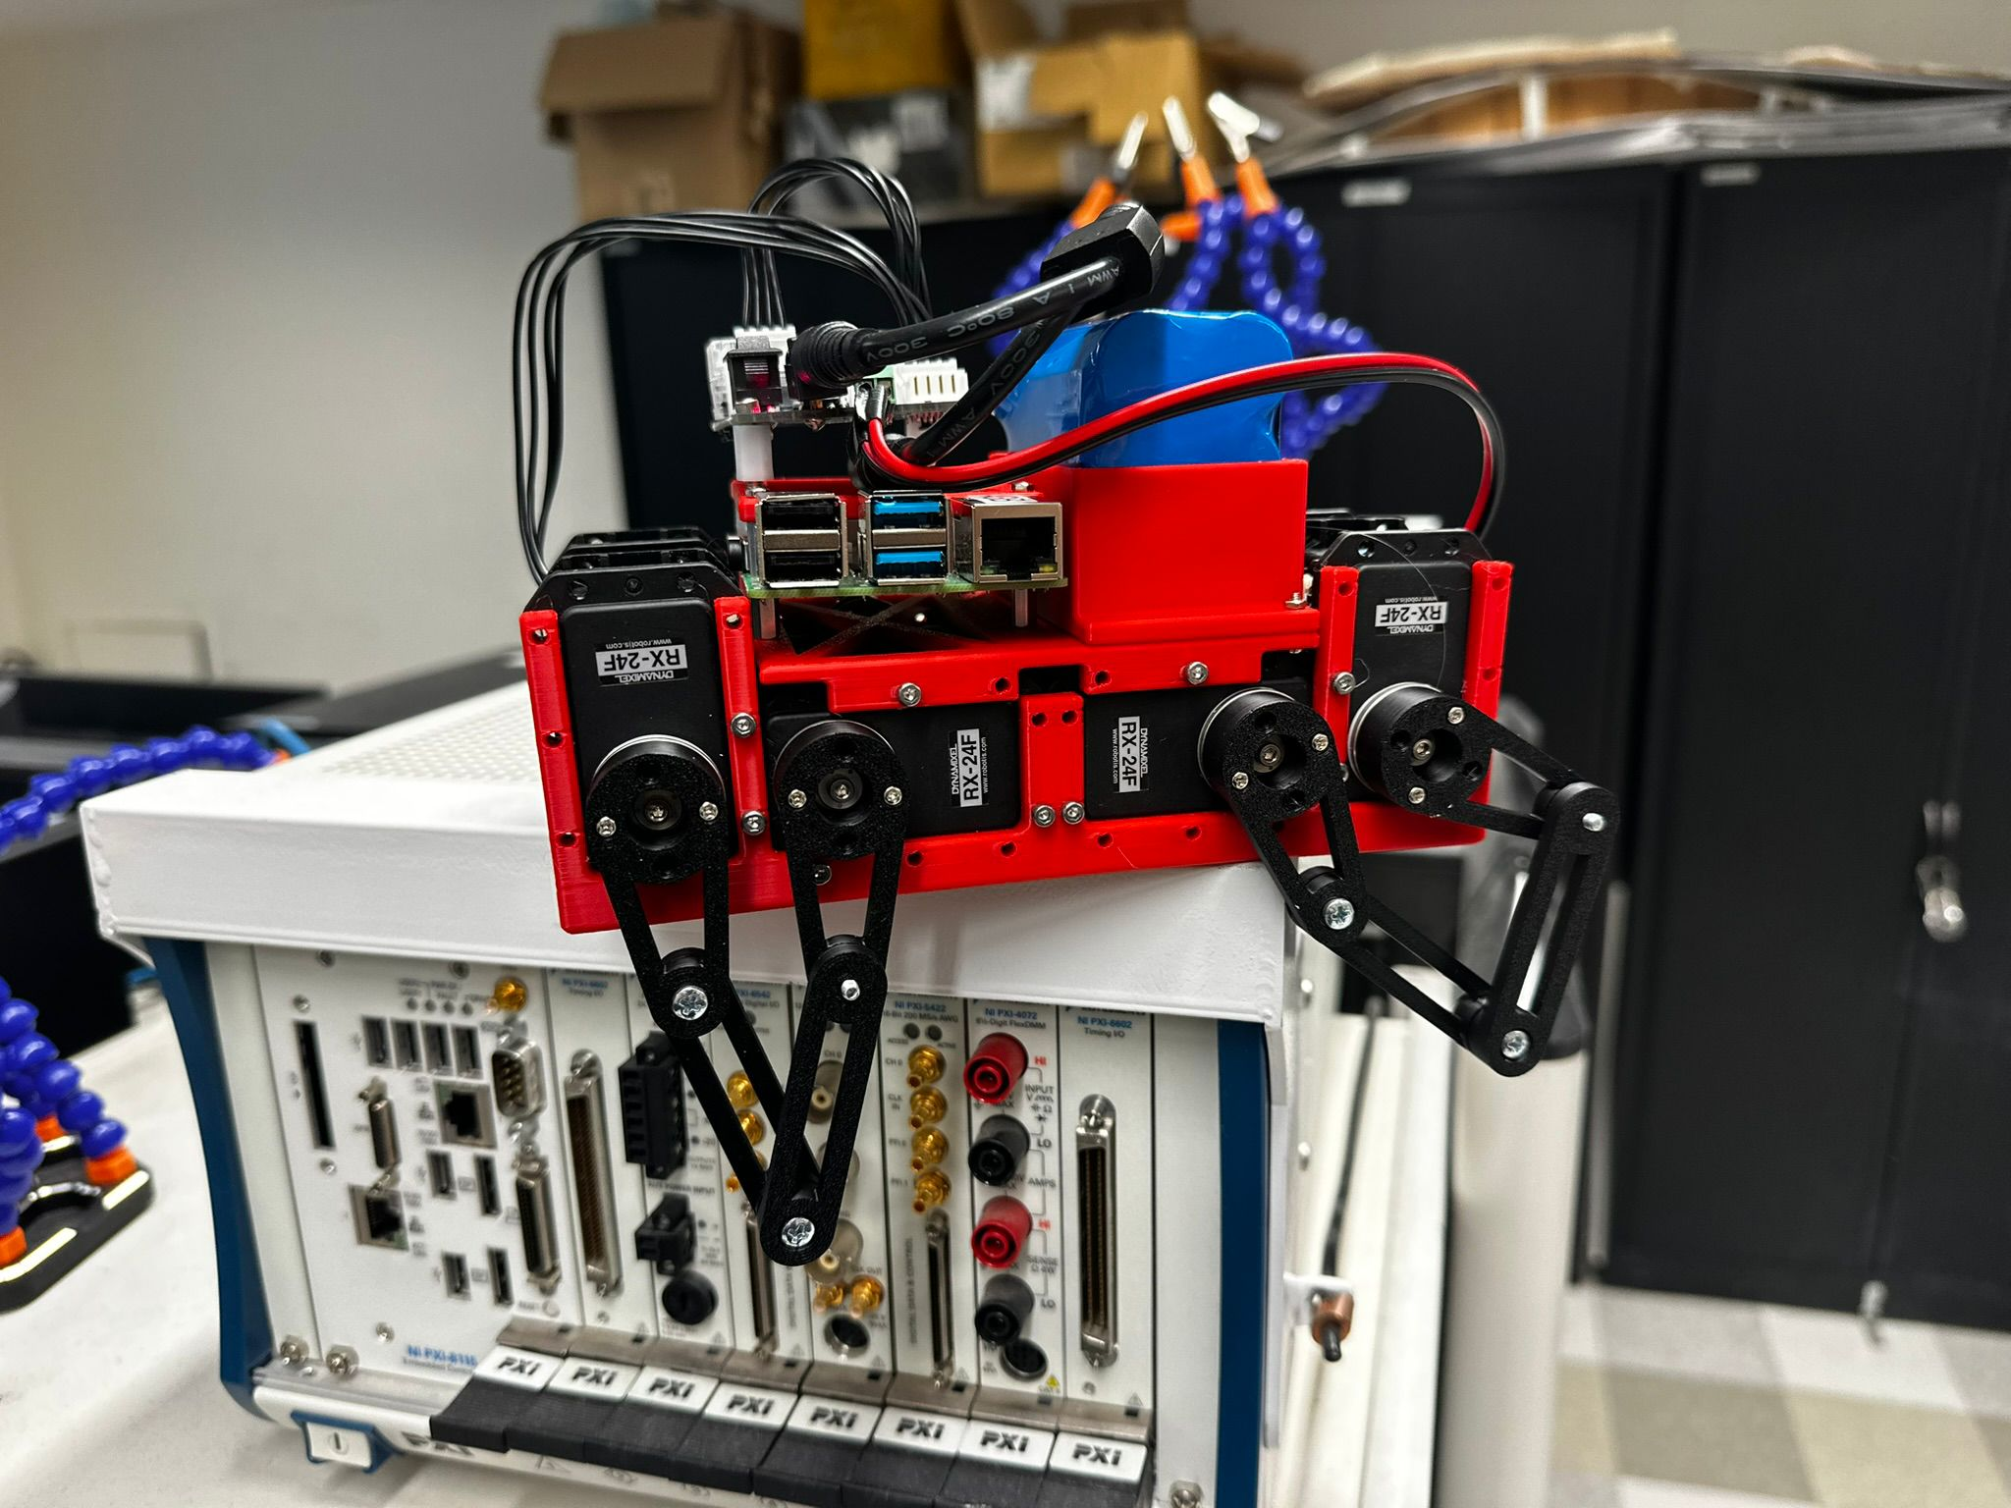
Del. 4C
Key Observations
Humidity varies across the greenhouse; it is not evenly distributed
A stationary humidifier does not provide full coverage
Robot movement improves humidity and liquid distribution
Sensor placement near plant level is important
These tests confirmed that a mobile robot with automatic humidity control is a feasible and effective solution.
(* Design subject to change.)
Materials Exploration & Early Prototyping
We gathered basic materials to test key subsystems of our greenhouse robot, including a humidity sensor, small humidifier module, and a 4-legged robot. We also used a spray bottle with water to represent nutrient liquid delivery.
We play-acted the robot’s behavior by manually moving the mockup through a marked greenhouse area while taking humidity readings at different locations and heights. When humidity dropped below a set threshold, we activated the humidifier to observe how quickly and how far moisture spread.
Figure 2: Early prototype picture

Slide 5
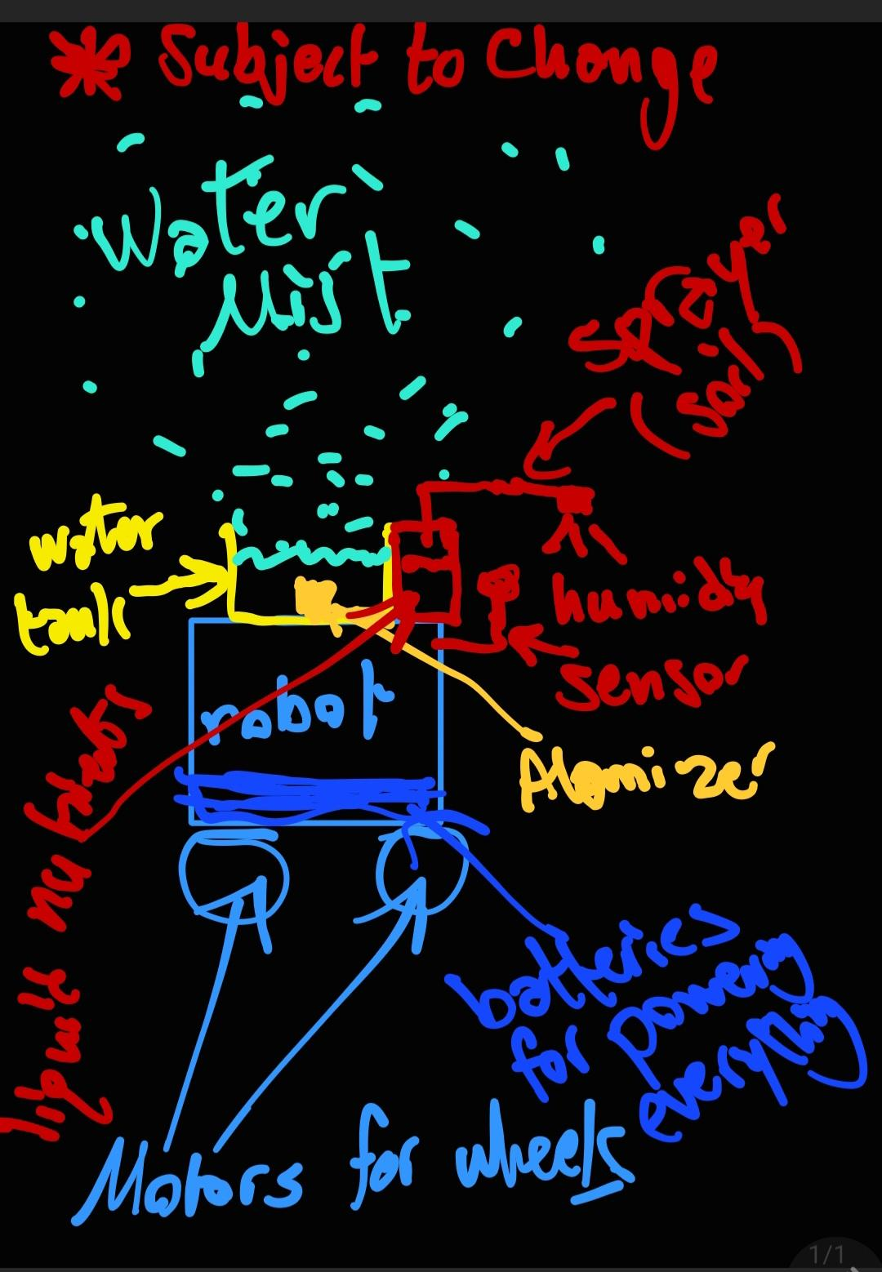
Del 4D
Figure 3: Deliverable 4.D Sketch *Subject to Change

